Slide 1


Learn JavaScript
Nagaraju Katta

Slide 2


Today’s Agenda
JavaScript Variables
JavaScript Data Types

Slide 3
JavaScript Variables
JavaScript variables are loosely typed, that is to say, variables can hold values with any type of data.
Variables are just named placeholders for values
Declare JavaScript variables using var keyword
To declare a variable, we use the var keyword followed by the variable name
var message;
After declaring a variable, we can assign the variable a string as follows:
message = “Hello”;
var message = “Hello”;

Slide 4
Undefined vs. undeclared variables
Undefined variable : An undefined variable is a variable that has been declared. Because we have not assigned it a value, the variable used the “undefined” as its initial value.
Undeclared variable : Undeclared variable is the variable that has not been declared.

Slide 5
Global and Local variables
In JavaScript, all variables exist within a scope that determines the lifetime of the variables and which part of the code can access them.
JavaScript mainly has :
Global scope
Function scope
Block scope ( Introduced in ES6)

Slide 6
Global and Functional and scope
Global scope : If you declare a variable outside of a function, JavaScript adds it to the global scope.
Function scope : If you declare a variable in a function, JavaScript adds the variable to the function scope

Slide 7
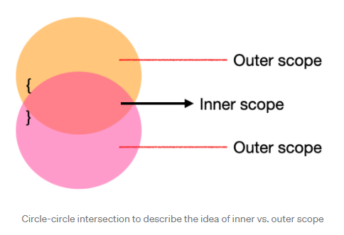
Variable shadowing
Variable shadowing occurs when a variable of an inner scope is defined with the same name as a variable in the outer scope.
In the inner scope, both variable’s scope overlap.

Slide 8
Strict mode in JavaScript
To avoid creating a global variables accidentally inside a function because of omitting the var keyword, we use the strict mode by adding the “use strict” at the beginning of the JavaScript file ( or the function)
“use strict”;
Use : It eliminate some JavaScript silent errors and make your code run faster

Slide 9
JavaScript Data Types
JavaScript has six primitive data types
null
undefined
boolean
number
String
symbol - available only from ES6
Complex data type
object

Slide 10
JavaScript is a dynamic language or loosely typed therefore a variable doesn’t associate with any type. However, its value does.
In other words, the same variable can hold values of different types at any time.

Slide 11
The undefined type
The undefined type
The undefined type is a primitive type that has one value undefined
By default, when a variable is declared but not initialized, it is assigned the value undefined

Slide 12
The null type
The null type is the second primitive data type that also has only one value: null
JavaScript defines that null is an empty object pointer
Note : It is a good practice to assign a variable that later holds an object to null

Slide 13
The number type
Integer numbers
let num = 100;
Floating-point numbers
let f1 = 12.5;
Note : JavaScript converts a floating-point number into an integer number if the number appears to be the whole number

Slide 14
NaN ( Not a Number )
JavaScript has a special numeric value called NaN.
The NaN has two special characteristics
Any operation with NaN returns NaN
The NaN does not equal any value, including itself.

Slide 15
The object type
In JavaScript, an object is a collection of properties, where each property is defined as a key-value pair

Slide 16
Home work & Assignment
Reading assignment
JavaScript shadowing
JavaScript Hoisting
Complete the assignment given

